Slide 1
EASE ASR Consolidation Tech Spec Review
November 2015

Slide 2
EASE ASR Consolidation
CenturyLink will implement the EASE ASR Ordering System Consolidation based on the milestone dates shown.
Consolidation Plan Milestone | Date
Customer Testing Begins with ASOG 51 Consolidation Functionality | January 18, 2016
Customer Testing Continues with ASOG 51 and 52 Consolidation Functionality | February 22, 2016
Customer Testing Ends | May 17, 2016
Customer Go / No Go Vote | May 17, 2016
Release to Production | May 30, 2016

Slide 3
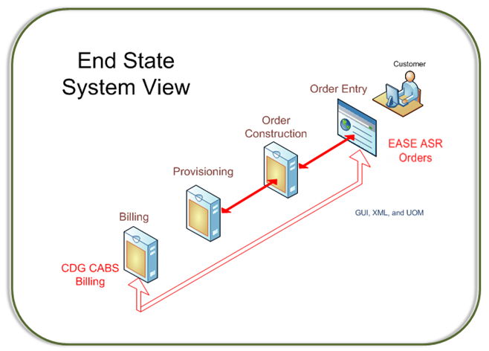
EASE ASR Consolidation
The following diagram shows CenturyLink’s Single ASR Ordering and Billing System and depicts the End State Ordering and Billing System for all CenturyLink Markets.

Slide 4
EASE ASR Consolidation
Wholesale Operation Support Systems debuted the Access Service Ordering and Billing Systems Consolidation (2016) website 10/30/15.
http://www.centurylink.com/wholesale/systems/ossconsolid.html

Slide 5
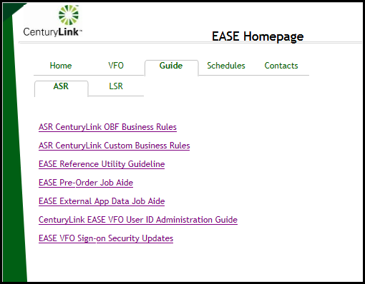
EASE ASR Consolidation
EASE Homepage provides easy access to:

Slide 6
Interface Tech Specs Documentation
EASE ASR Consolidation

Slide 7
Interface Tech Specs
The following Technical Specifications have been created to assist in the consolidation effort:
EASE ASR Info Guide
CenturyLink EASE ASR Information Guide provides overall information for EASE Ordering System, such as pre-order, order, and post-order functions.
EASE Summary of Changes
Summary of Changes defines the changes of CenturyLink’s Custom Business Rules from the previous release of EASE, providing information related to the form, field, and error codes.
EASE ASR Tech Specs
CenturyLink EASE ASR Technical Specifications provide the summary of changes for the previous release, as well as a complete list of CenturyLink Custom Business Rules and Error Messages, color coded as blue indicates a change in a rule or error message, and red indicates a new or removed rule or error message.

Slide 8
Interface Tech Specs
EASE ASR Order Tech Specs
CenturyLink EASE ASR Order Technical Specifications contains information to implement UOM XML system interface with CenturyLink for order functions, including supported services, interface architecture, WSDL & ASR flow, SOAP structure, as well as SOAP fault codes and messages.
EASE ASR Pre-Order Tech Specs
CenturyLink EASE ASR Pre-Order Technical Specifications contains information to implement UOM XML system interface with CenturyLink for pre-order functions, including supported services, interface architecture, WSDL & ASR flow, SOAP structure, as well as SOAP fault codes and messages.
EASE Implementation Guideline
ASR Implementation Guidelines – EASE UOM XML Interfaces describes the procedure and activities to implement UOM XML interface with CenturyLink, including communication, requirements, documentation overview, connectivity testing, the testing process, and production support.

Slide 9
EASE – CORA Comparison
EASE ASR Consolidation

Slide 10
EASE –CORA Comparison
EASE is used by all Customers, including CenturyLink, as the end state ASR submission and results portal. EASE is used for ASR processing via a GUI and batch files, and real-time XML transactions.
CORA is an internally developed ASR submission and results portal, allowing ASR processing via a Graphical User Interface (GUI) and batch files, and real-time eXtensible Markup Language (XML) transactions.
Both EASE and CORA are OBF compliant systems.

Slide 11
EASE –CORA Comparison
Functionality includes:
EASE | CORA
Pre-order information queries | Pre-order information queries
Validations/Edits | Validations/Edits
ASR submission | ASR submission
Status Information | Status Information
CDG CABS is the end state system that bills Customers for services ordered through EASE.
IABS is the system that bills Customers for services ordered through CORA.
Note: See Appendix 1 for the comparison matrix between EASE and CORA

Slide 12
EASE – CORA Comparison
Access Service Ordering Differences between EASE and CORA
Each Owner Agent has a single login in CORA and is able to submit ASRs for all companies he/she represents. In EASE, an Owner Agent has a single login for a company and for all related companies within the same hierarchy. Separate login IDs will be required if related companies have separate hierarchies in ordering. In this instance, an Owner Agent submits orders for multiple companies by having multiple browser sessions opened, one for each company. This feature provides stronger controls to prevent unauthorized user access.
Comprehensive Global Validation – When a Customer enters an order, CORA provides form level validations on demand. CORA experiences its validation optionally after each page completion, as well as systematically when the Customer submits the order. EASE provides validations on demand, during the order entry process, and before order submission.

Slide 13
EASE – CORA Comparison
Access Service Ordering Differences between EASE and CORA
As part of CenturyLink’s efforts to reduce customer clarifications and jeopardies and decrease provisioning intervals, EASE requires more up-front validations (or edits) than CORA because EASE provides more efficient flow through of the ASR Orders.
All orders entered in EASE VFO must be in all capital letters. Hint: set your Caps Lock button on the keyboard before entering an order.
BAN Inquiry Pre-Order functionality will be available in EASE in December 2015.
Pre-Order function for NC/NCI Inquiry is accessed via the Order Tab in EASE, while it is accessed via the Pre-Order Tab in CORA.

Slide 14
EASE –CORA Comparison
Batch Processing
The Industry Ordering and Billing Forum (OBF) directive will retire the industry Batch Standard by the end of 2016.
As communicated in January 2015, CenturyLink will be consolidating its ASR systems by replacing the CORA ASR processing system with the CenturyLink EASE system May 30, 2016. In order for customers to save time and expense, CenturyLink recommends customers wait to migrate to EASE UOM at the time of the ASR system consolidation rather than moving to CORA UOM prior to that consolidation

Slide 15
EASE Virtual Front Office
EASE ASR Consolidation

Slide 16
EASE Virtual Front Office
EASE Virtual Front Office (VFO) is accessed via the EASE Homepage: http://ease.centurylink.com/ease.jsp

Slide 17
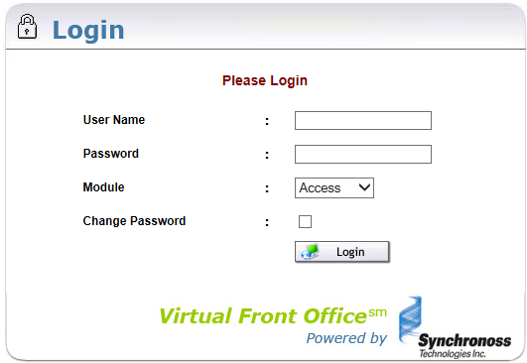
EASE Virtual Front Office
EASE users are required to log in with a User Name and Password

Slide 18
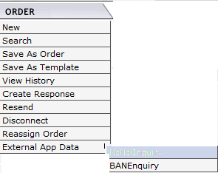
EASE Virtual Front Office
Upon successful log in, the user is presented with the Order List Page.
Across the top of the
page are three tabs:
The order tab
provides:

Slide 19
EASE Virtual Front Office
The pre-order tab allows the user to
create a new pre-order for CLLI Scan,
Address or CFA Validation, or view
previous pre-order searches.
The template tab allows the user to
create a new ordering template or
search for existing templates.

Slide 20
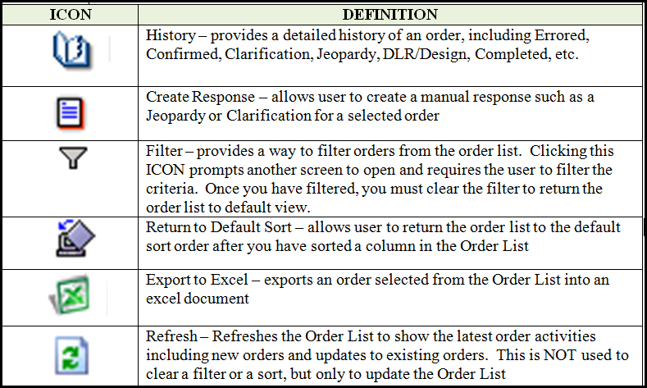
EASE Virtual Front Office
The upper right corner of the EASE VFO home page presents 6 action ICONS to select.

Slide 21
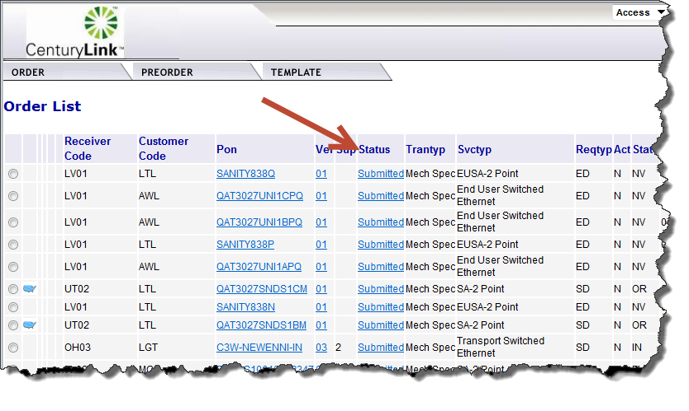
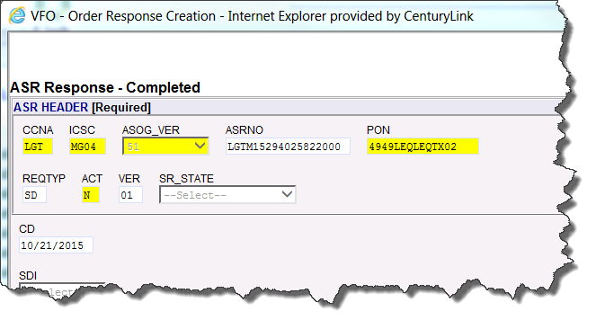
EASE Virtual Front Office
The Status column in EASE VFO shows you the current status of orders in the Order List. Clicking the status hyperlink will open the order for your review.

Slide 22
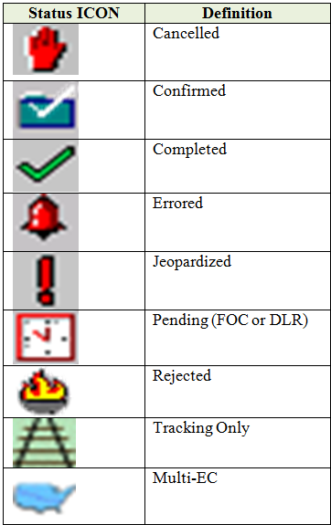
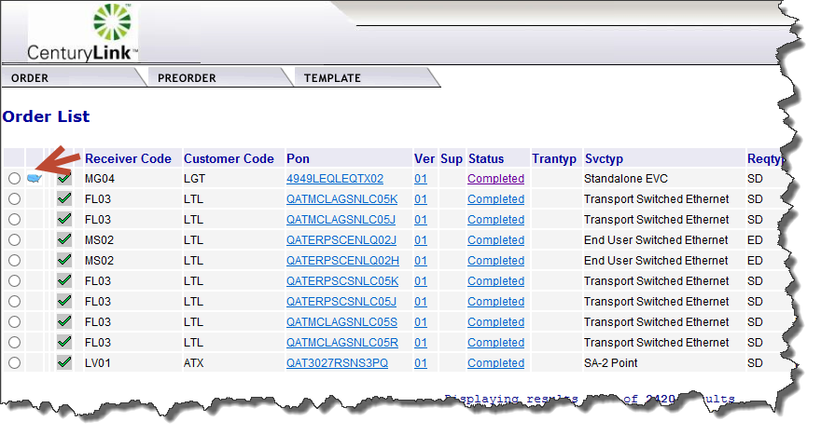
EASE Virtual Front Office
Status ICONS may display to the left of the Receiver Code column on the Order List. These are designed to assist with identifying the current status of orders.

Slide 23
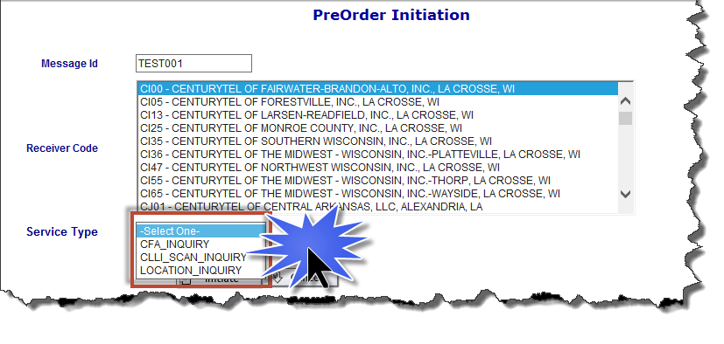
EASE Virtual Front Office
ASR Pre-Order functionality allows the user to initiate new:
*CFA Inquiry *CLLI SCAN Inquiry *Location Inquiry
*BAN Inquiry deploying in December 2015

Slide 24
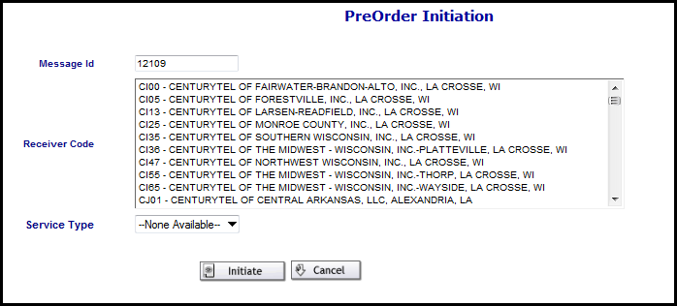
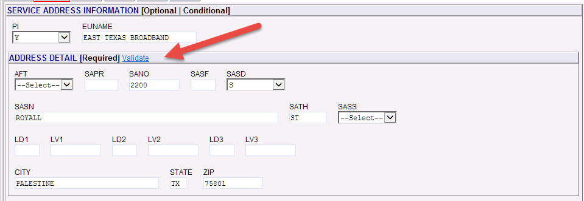
EASE Virtual Front Office
ASR Pre-Order
Using preorder functionality ensures good data is present on the order before it is submitted to CenturyLink. If a CenturyLink address preorder is not done by using the PreOrder tab menu, the user can perform an address preorder during order initiation.
Address preorder validation during order initiation
Preorder Initiation

Slide 25
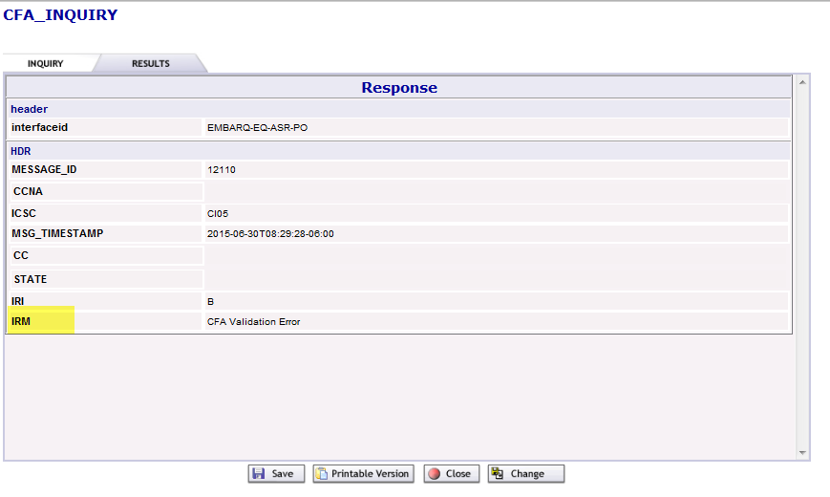
EASE Virtual Front Office
ASR Pre-Order Results
Once the query is initiated, the results will display on the Results tab. The IRM field shows whether or not the preorder was successful.
Information Request Message

Slide 26
EASE Virtual Front Office
ASR Pre-Order Search
Selecting Search from the Preorder tab drop-down menu enables you to search for an existing preorder. If a preorder has been previously done, there is a PON or other ID attached to that preorder based on what was placed in the Message ID or TX NUM field at the time of the initial preorder. You can also search for other more general information.

Slide 27
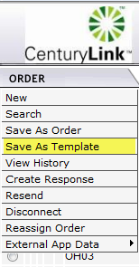
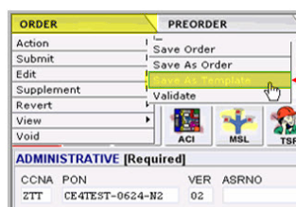
EASE Virtual Front Office
ASR Template New
Order Templates can be initiated in three ways:
Choose Save As Template from the Order Tab
Choose Save As Template from
the Action sub menu tab
Choose New from the Template tab menu

Slide 28
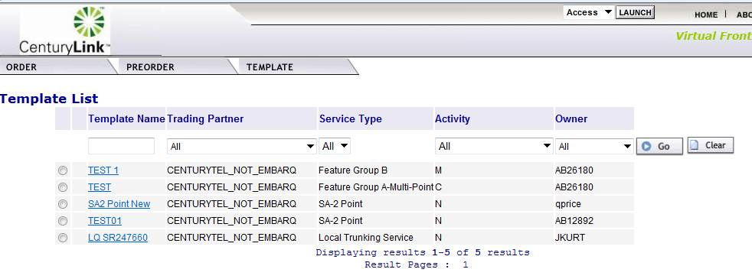
EASE Virtual Front Office
ASR Template Search
A user can search for a template by selecting the Search option under the Template Tab.
A user can modify or delete existing templates.

Slide 29
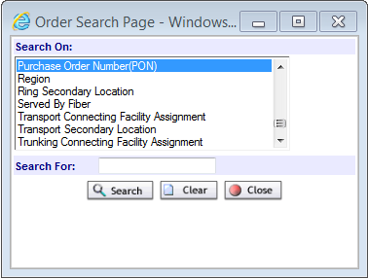
EASE Virtual Front Office
ASR Data Search
A user can access the Order tab Search option to find different search criteria, view the history of an order including Clarifications, Jeopardies, Completions,
etc., and search for an
modify existing templates.
Note: A partial search can be performed by entering part of the search criteria followed by a %. This is considered a wildcard or partial search.

Slide 30
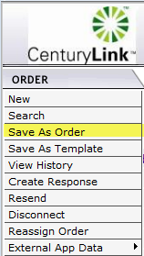
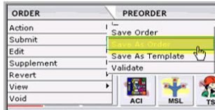
EASE Virtual Front Office
ASR Order Replicate
A user can replicate an existing order to use for new order creation in EASE VFO. The order that you replicate (copy) is for a one time use. If you want to make a shell order for use on a go forward basis, you would create a template and not replicate an existing order. Replication requires the user to change the existing PON.
Replicating an order can be done two ways:
From the Order Tab when the order list is in view:
From the Order Tab when in an existing order

Slide 31
EASE Virtual Front Office
ASR Order Entry
EASE VFO contains all the industry standard forms and fields that are required to enter an Access Service Request (ASR). There is help text available for each field once you are in an order. The help text may assist you with correcting errors or choosing valid field values. The help text for each field displays at the bottom of the screen after you click in the field.

Slide 32
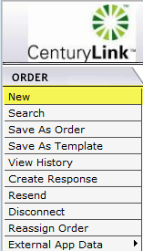
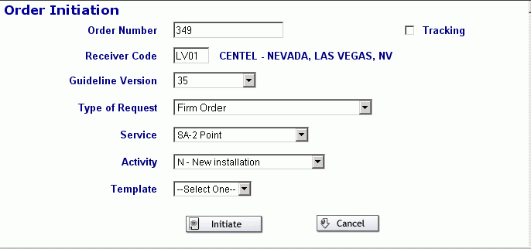
EASE Virtual Front Office
ASR Order Entry
To create an order, select new from the Order tab:
The Order Initiation window displays and the user will enter basic ordering criteria. Once the Initiate button is clicked, the user will be navigated to the order.

Slide 33
EASE Virtual Front Office
ASR Order Entry
General information populated on the Order Initiation screen will populate onto the order. The default populates with the ASR Form. Change forms by clicking on the forms on the menu bar.

Slide 34
EASE Virtual Front Office
ASR Order Page ICONs
The user will see several ICONs in the upper right corner of the page.
 | Save
 | Validate
 | Submit
 | Supplement Cancel
 | Supplement DDD Change
 | Supplement Others
 | History
 | Print
 | Refresh
 | Close

Slide 35
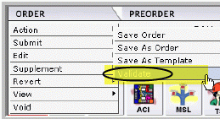
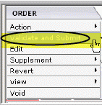
EASE Virtual Front Office
ASR Order Validation
Once the required forms and fields have been completed, the order must be validated prior to being submitted. There are three ways to perform order validation.
Click the Validation ICON in the top right corner of the order
Select Validate from the Action sub-menu of the
Order Tab menu while you are in an order.
Select Validate and Submit from the Order
Tab menu while you are in an order.

Slide 36
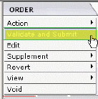
EASE Virtual Front Office
ASR Order Submission
Once order validation is performed and the order is error free, the Status field will change to ‘validated’ and the order is ready to be submitted. There are two ways to submit an order.
Click the Submit ICON in the top right hand corner of the order.
Select Validate and Submit from the Order Tab
drop-down menu.
The status field in the order will change to Sent,
then will change to Submitted, then Accepted.
This means the order was submitted to CenturyLink and you are done with your order entry unless you want to supplement the order.

Slide 37
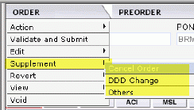
EASE Virtual Front Office
ASR Order Supplements
You can make changes or cancel and order all the way up to the point at which the order changes to Completed status. There are two ways to Supplement an order:
Click the 1, 2 or 3/4 ICON in the top right of the order to initiate the supplement.
1 = Supplement Cancel
2 = Supplement DDD Change (Due Date Change)
3 / 4 = Supplement Others
Select Cancel, DDD Change, or Others from the
Order Tab Supplement sub-menu.
Each time a Supplement is submitted and accepted, the version field increases by “1”

Slide 38
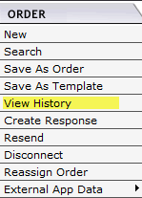
EASE Virtual Front Office
ASR Order History
There are several ways to view the history of an order in EASE VFO.
Click the History ICON when an order is selected from the Order List.
Clicking the History ICON while viewing an order.
Selecting View History from History sub-menu
of the Order tab while viewing an order

Slide 39
EASE Virtual Front Office
Reference Table Lookup
Reference Table Utility provides a method to validate key information to enter accurate information for an Access Service Request (ASR) within EASE VFO.

Slide 40
EASE Virtual Front Office
Reference Table Lookup
CLLI Codes can be searched by CLLI Code, CLLI Category Code, or LATA Code

Slide 41
EASE Virtual Front Office
Reference Table Lookup
NC/NCI Codes can be searched by NC CD, NCI CD, SECNCI CD, ASR Type Code, Company. A wildcard search is allowed, using the search character of “%”

Slide 42
UOM XML Interface
EASE ASR Consolidation

Slide 43
UOM XML Interface
System Requirements
Web Services over HTTP/HTTPS
SOAP version 1.2
WSDL 1.1
Referenced Documents
ATIS Document for UOM ASR
UOM ASR XML Schema
Note: CenturyLink customers must purchase / procure the above referenced documents from ATIS.

Slide 44
UOM XML Interface
Supported ASR Order Services (Asynchronous)
UOM ASR XML is used as payload for the ASR Order request and responses. The following order request and responses are supported.
ASR Order Request (includes supplement orders)
ASR Acceptance Response
ASR Rejection Response
ASR TP Errored Response
ASR Firm Order Confirmation Notification
Error Clarification Notification (CNR Error)
Previous CNR Clear Notification
Jeopardy Notification
Jeopardy with Errors Notification
ASR Provider- initiated Cancellation Notification
ASR Remarks Notification
Design Layout Report Notification
ASR Order Completion notification

Slide 45
UOM XML Interface
Supported ASR Pre-Order Services (Synchronous)
UOM ASR XML is used as payload for the ASR Pre-Order request and responses. The following pre-order requests are supported and note that response is returned synchronously.
CFA pre-order Inquiry
Location pre-order Inquiry
BAN Inquiry (Dec. 2015)

Slide 46
UOM XML Interface
UOM XML Implementation
Initial Communications: During this phase, all activities to initiate a CLEC/IXC/WSP’s implementation are discussed, and the kickoff conference call is held to introduce specific team members.
Implementation Project Plan or Industry Upgrade Test Plan Negotiation: During this phase, the Implementation Project Plan or Migration Test Plan is proposed, negotiated and approved.
Requirements Review: The Requirements Review phase provides an opportunity for a CLEC/IXC/WSP to review CenturyLink’s Business Rules Differences Lists for pre-order and order and ask any questions they may have regarding those requirements.

Slide 47
UOM XML Interface
Establishing Connectivity Testing: During this phase, the CLEC/IXC/WSP’s connectivity is established and tested. This phase is used to establish that an internet connection can be facilitated to send and receive transactions using web services.
New Implementation/Industry Upgrade Testing: This phase affords the CLEC/IXC/WSP the opportunity to validate their technical development efforts and to quantify ASR processing results. CenturyLink provides an environment for testing the EASE interface functionality.
6. Production: The CLEC/IXC/WSP moves to production once testing is completed, or when the Industry ASOG upgrade occurs. With the new EASE implementations, a CenturyLink SME Project Manager will work closely with the wholesale customer to insure a successful turn up. Following that initial implementation, CenturyLink will provide ongoing SME support as required.

Slide 48
Additional Assistance
EASE ASR Consolidation

Slide 49
EASE ASR Consolidation
Additional Assistance is available:
ASR Ordering System Information: http://www.centurylink.com/wholesale/systems/ossconsolid.html
EASE Training: http://training.centurylink.com/ease
Tech Specs are posted: http://www.centurylink.com/wholesale/cmp/review.html
Address Validation Utility, Virtual Front Office, and Reference Table Lookup: http://ease.centurylink.com/
Via email: Helpdesk.EASE@CenturyLink.com.
Via Phone: EASE Helpdesk - 913.353.7439

Slide 50
Presentation Questions

Slide 51
Appendix 1
EASE ASR Consolidation

Slide 52
EASE –CORA Comparison
The following matrix is a comparison of functionality between EASE and CORA
Functionality | CORA | EASE
Support eBonding and portal for ASR requests | Yes | Yes
Industry standard ASR forms and fields | Yes | Yes
Pre-Order Query
Scan CLLI codes | Yes | Yes
Validate a CFA | Yes | Yes
Validate NC/NCI/SecNCI | Yes | Yes
Validate Address | Yes | Yes
Validate a BAN | Yes | Yes

Slide 53
EASE – CORA Comparison
Functionality | CORA | EASE
Create and submit a request | Yes | Yes
Revise a rejected request | Yes | Yes
Supplement a request | Yes | Yes
Up front order editing | Yes | Yes
Search ASRs | Yes | Yes
Wildcard Search | Yes | Yes
Order Tracking | Yes | Yes
Order Replication and Template Creation | Yes | Yes
Online Help | Yes | Yes
Field Level Help | Yes | Yes
View Confirmations | Yes | Yes
Receive Design Layout Reports (DLRs) | Yes | Yes

Slide 54
EASE – CORA Comparison
Functionality | CORA | EASE
Order History | Yes | Yes
Order Status | Yes | Yes
Customer user admin functionality | Yes | Yes
Reporting | Yes | Yes

